Slide 1
PDF Entity Extraction and Knowledge Graph Visualization using Python
Defectech Assignment
Jerrybritto Johnbritto
Master of Data Science
Macquarie University

Slide 2
Problem Statement
The goal of this project is to design a Python system that extracts structured information from an unstructured PDF document and transforms it into a knowledge graph.
PDF files are difficult to process because they contain inconsistent formatting, mixed layouts, and noisy text such as headers and correspondence messages. The challenge is to automatically identify meaningful entities and relationships while filtering irrelevant information.
The final objective is to visualize these relationships in a clear and interpretable graph.

Slide 3
Project Goal & Approach
Goal: Convert raw PDF text into relational knowledge.
Approach:
  Read PDF text
  Clean and preprocess lines
  Extract names and emails using regex
  Infer organizations from email domains
  Build a knowledge graph
  Visualize relationships
This pipeline transforms unstructured text into structured semantic data.

Slide 4
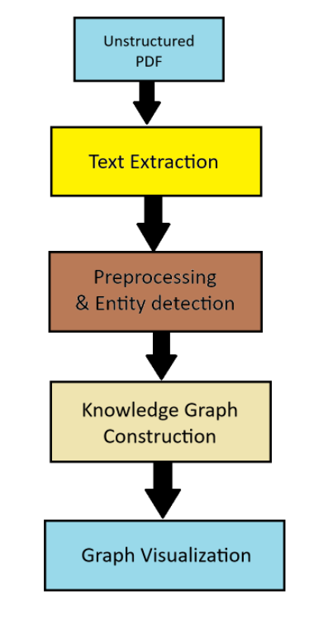
System Architecture
Architecture
PDF Text Entities Knowledge Graph Visualization
The system is designed as a modular pipeline where each stage performs a specific task. The text extraction module converts the PDF into clean lines. The preprocessing stage removes noise and identifies entities using regex. The graph construction stage transforms entities into nodes and relationships. Finally, the visualization module renders the knowledge graph using a dynamic layout.

Slide 5
Tools & Libraries
Tools Used
  Visual Studio Code (VS Code) for coding and debugging
  Python as the programming language
Libraries Used
  pdfplumber text extraction
  Regex entity detection
  NetworkX KG graph modeling
  Matplotlib visualization
  Textwrap wrap labels inside nodes

Slide 6
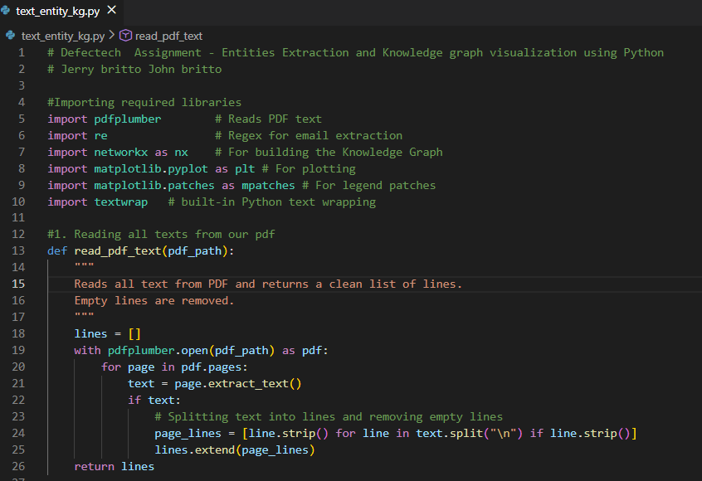
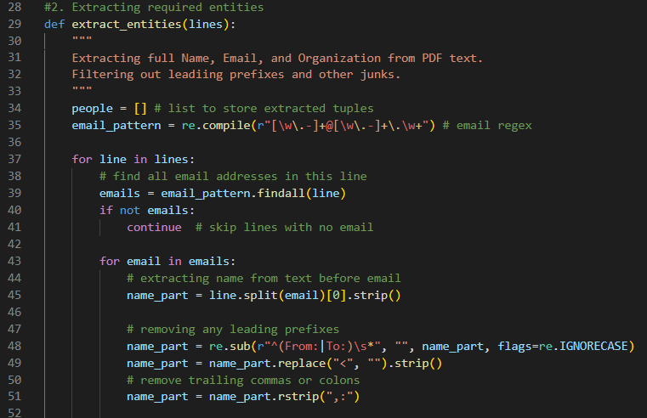
Code Implementation – Data Extraction
Imports libraries for PDF reading, regex processing, and graph building.
read_pdf_text() extracts and cleans text from all PDF pages.
Lines are stripped to remove empty spaces and formatting noise.
Meta data for extraction is Name, Organization and Email.
extract_entities() finds valid email addresses using regex.
Names are cleaned by removing prefixes like From: and symbols.
Organization is inferred automatically from the email domain.
Duplicate entries are removed to keep unique records only.
Output is structured as Name – Email – Organization tuples.

Slide 7
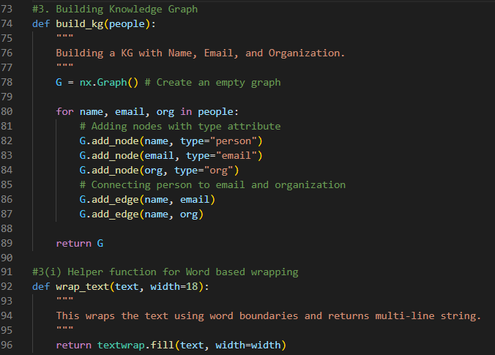
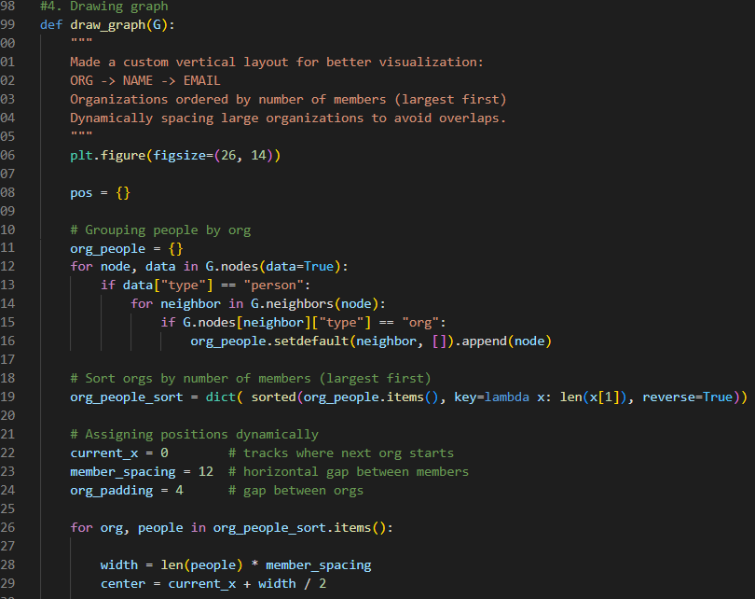
Code Implementation – Graph Visualization
build_kg() converts extracted entities into graph nodes.
wrap_text() helps labels fit inside visualization nodes.
draw_graph() creates a structured layout grouped by organization.
Members of the same organization are spaced evenly.
Emails are positioned directly below their owners.
Dynamic spacing prevents node overlap.
Colors differentiate people, emails, and organizations.
Labels are wrapped for readability inside nodes.
A legend explains node categories clearly.
Final output is a clean knowledge graph of relationships.

Slide 8
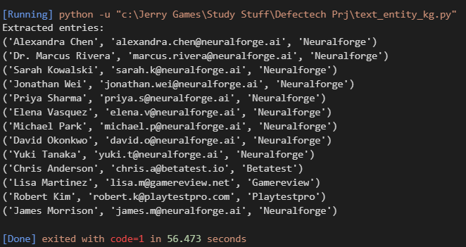
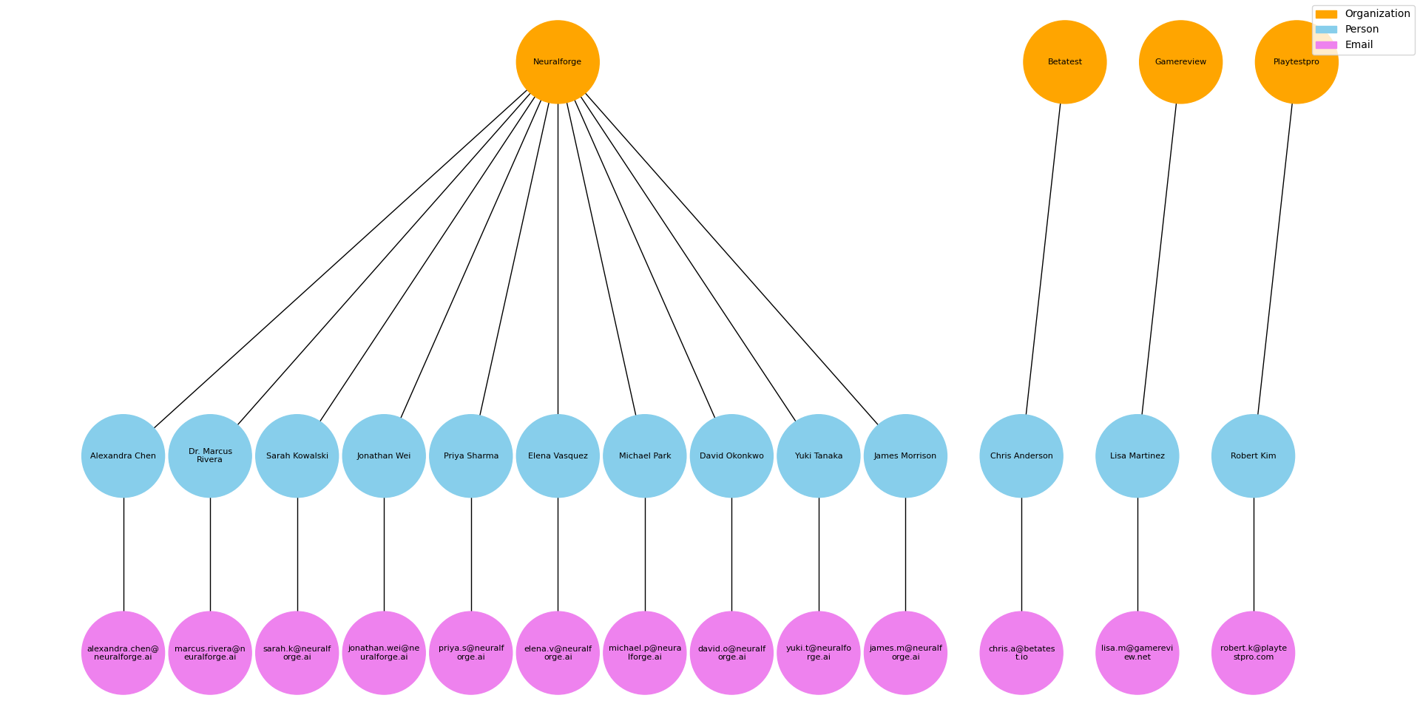
Final Outputs
Fig 1. Extracted Entries:
Shows the final list of all entities extracted from the PDF.
Each row contains a person’s full name, email, and organization.
Duplicate entries have been removed to ensure uniqueness.
Preprocessing cleaned unwanted lines and headers from the PDF.
This text output confirms that entity extraction is accurate and complete.
Fig 2. Knowledge Graph – Largest Org First, Custom Vertical Layer:
Visualizes the knowledge graph after sorting orgs. by size.
Largest organization (NeuralForge) appears first, on the left.
Other smaller orgs. are placed sequentially to the right.
Nodes are stacked vertically: Organization - Person - Email, improving readability.
Dynamic horizontal spacing prevents overlapping nodes and edges.
Labels are wrapped to ensure names and emails fit inside nodes.
Graph is clean, easy to follow, and clearly shows relationships.

Slide 9
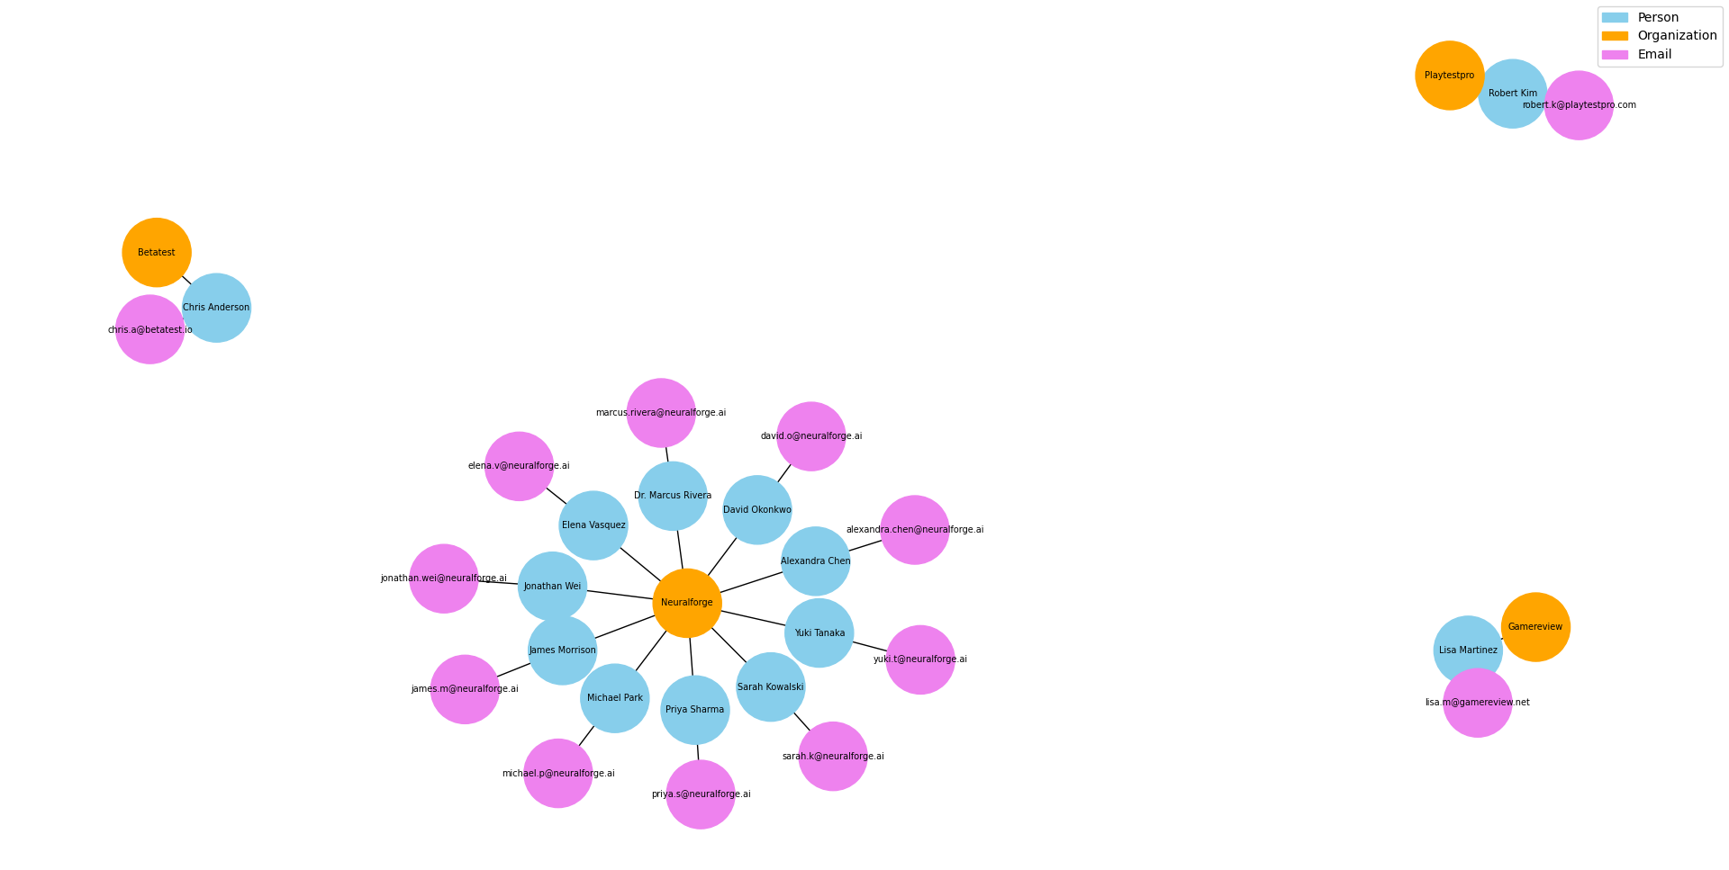
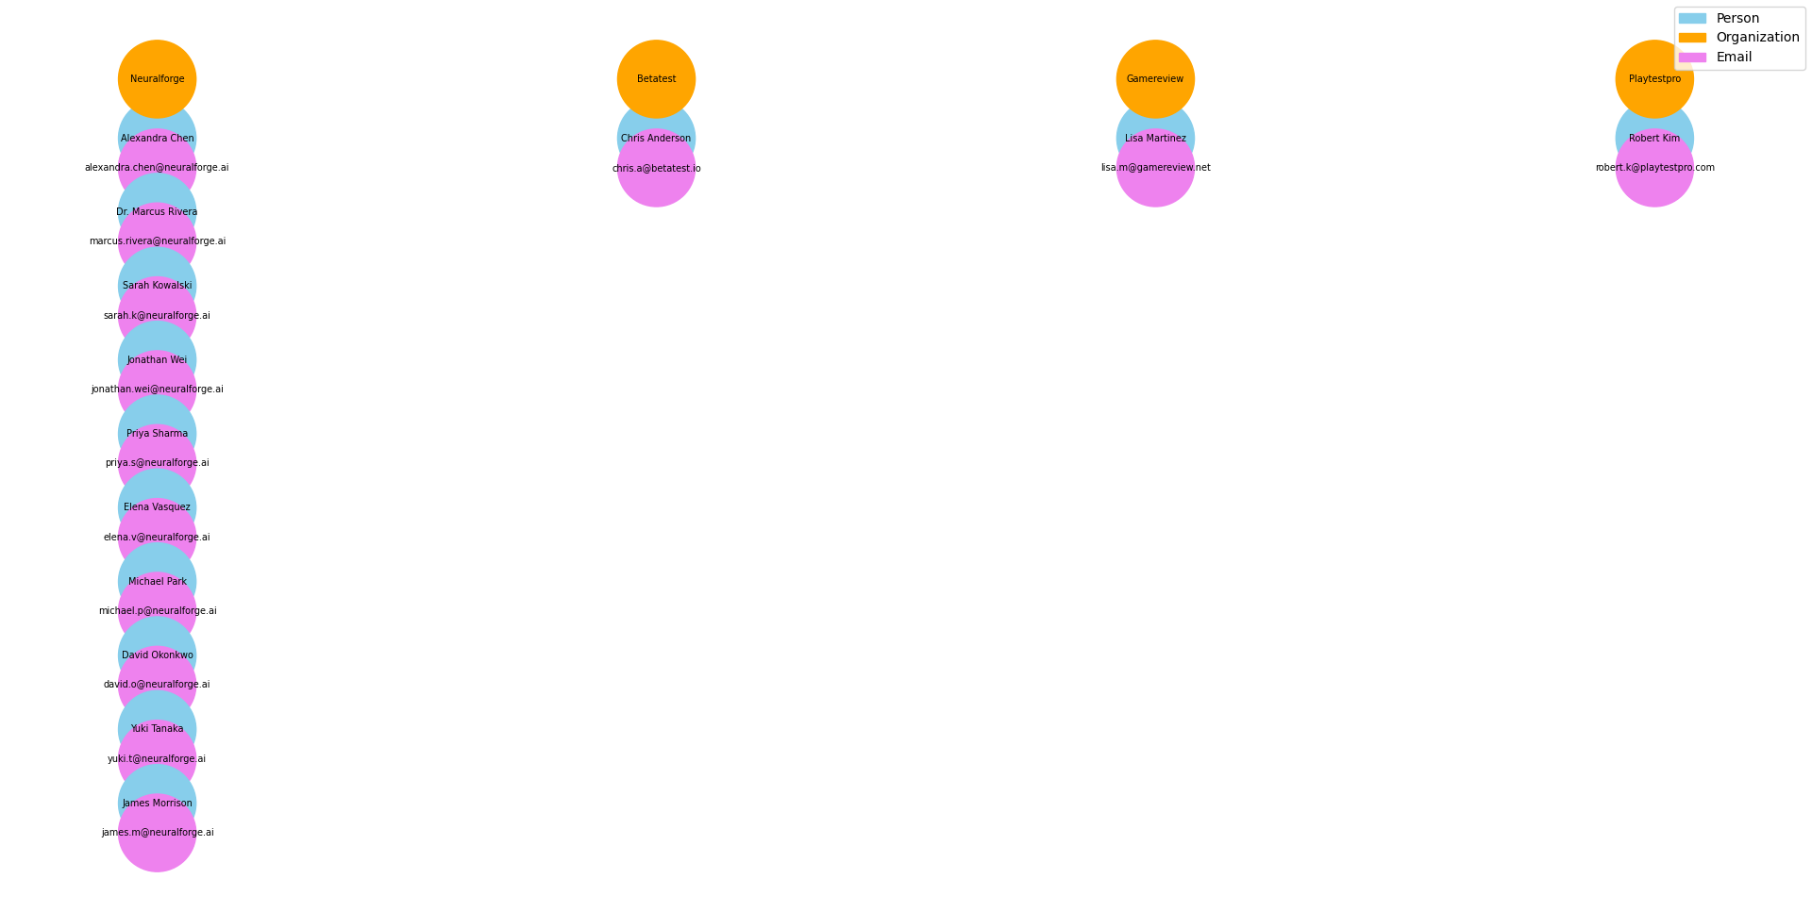
Output Comparison Layouts
Fig 3. Default Layout (Spring Layout):
Graph generated using NetworkX’s default spring layout.
Nodes are automatically placed based on force-directed simulation.
Graph appears cluttered with overlapping nodes and edges.
Labels are difficult to read, especially for organizations with many members.
Shows why a custom layout was necessary for clarity.
Fig 4. Vertical Layout (1st version):
First version of vertical layout without wrapping labels and sorting organizations by size.
Nodes stacked vertically, but spacing is inconsistent.
Some connections are buried under overlapping nodes.
It shows the need for adjusting dynamic spacing for improved readability and understandability

Slide 10
Considerations
PDF documents contain noisy formatting and mixed layouts, making structured extraction difficult.
Table-based extraction is unreliable when tables span multiple pages, so a text-based regex approach was chosen.
Open-source libraries such as pdfplumber and NetworkX provide flexibility but require custom preprocessing and layout control.
Metadata quality directly affects graph accuracy, so duplicate filtering and text cleaning were essential.
A modular workflow ensures that extraction, graph construction, and visualization can run independently.
Dynamic layout was necessary to prevent node overlap when organizations have different numbers of members.

Slide 11
Future Development
Extend entity extraction to include additional attributes such as roles and other required entities.
Apply Named Entity Recognition (NER) models for more accurate semantic extraction.
Store the knowledge graph in a graph database such as Neo4j for interactive querying.
Replace static visualization with an interactive web-based graph explorer.
Add automated validation to detect incorrect or incomplete entity links.

Slide 12
Conclusion
Our project successfully demonstrates a complete pipeline for extracting structured information from an unstructured PDF and representing it as a knowledge graph. Using PDF text extraction, preprocessing, and pattern-based entity detection, the system accurately identified people, their email addresses, and associated organizations, even when the document contained tables spanning multiple pages or noisy correspondence lines. The extracted entities were transformed into a graph with nodes and edges, showing clear relationships between individuals and organizations.
A custom vertical layout with dynamic spacing and largest-organization-first ordering ensured the graph remained readable, preventing overlapping nodes and maintaining a clear hierarchy with organizations at the top, people in the middle, and emails at the bottom. The modular design allows each stage: extraction, entity detection, graph construction, and visualization to run independently, making the pipeline scalable and easy to extend. This approach can be further improved by including additional entity types, such as roles, or using interactive visualization tools like Neo4j, demonstrating a practical and robust solution for converting unstructured text into interpretable knowledge.

Slide 13
THANK YOU!

